Slide 1
Key Biometric Processes

Slide 2
Key Biometric Processes
Enrollment Process
Recognition Process
  Verification (1:1 Matching)
  Identification (1:N Matching)
  Template Update and Maintenance

Slide 3
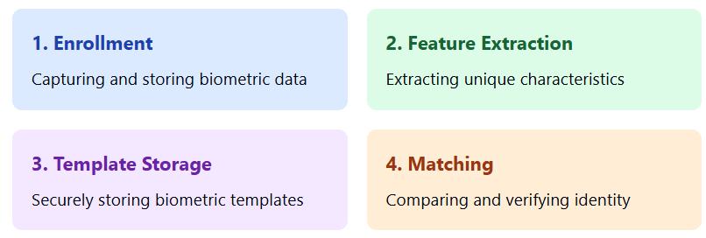
Overview of Biometric System
A biometric system consists of four main processes:

Slide 4
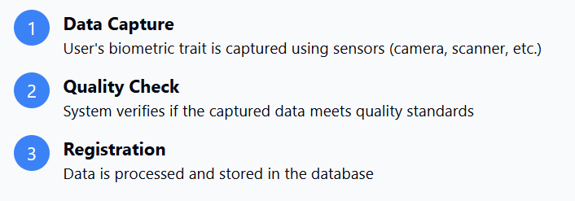
1. Enrollment Process
The first step in any biometric system
Example:
Enrolling your fingerprint in a smartphone - you place your finger multiple times on the sensor until the system captures enough data points.

Slide 5
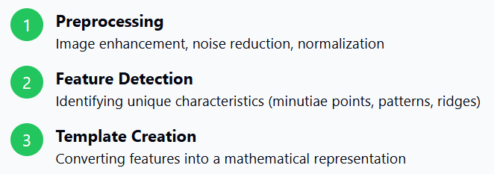
2. Feature Extraction
Converting biometric data into a unique digital template
Example:
In iris recognition, the system extracts patterns from the colored part of the eye, identifying unique features like furrows, crypts, and rings, then converts them into a binary code.

Slide 6
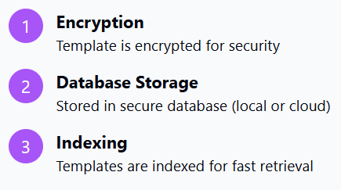
3. Template Storage
Securely storing the biometric template
Example:
Your face template in Face ID is stored in a secure enclave on your iPhone, encrypted and never sent to Apple's servers or accessible by apps.

Slide 7
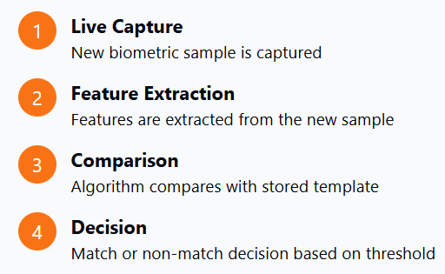
4. Matching Process
Comparing live biometric data with stored template
Example:
When you unlock your phone with fingerprint, the system captures your print, extracts features, compares with stored template, and grants access if similarity score exceeds the threshold.

Slide 8
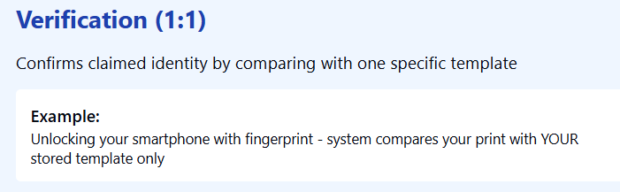
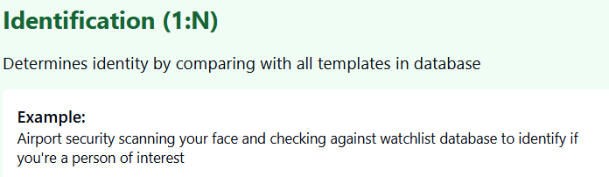
Types of Matching

Slide 9
Key Biometric Processes: Verification & Identification
Verification (1:1 Matching)
Asks: "Are you who you claim to be?" The user claims an identity and presents their biometric. The system compares it to a single, pre-stored template. This process is about confirming a declared identity.
Identification (1:N Searching)
Asks: "Who are you?" The user presents their biometric, and the system searches the entire database to find a match among many. This is used when the identity is unknown.

Slide 10
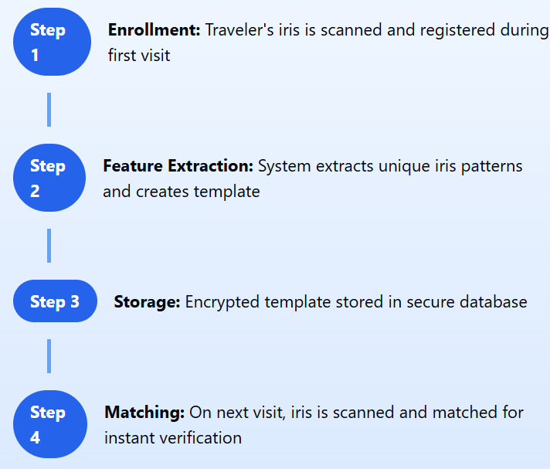
Real-World Application Flow
Iris Recognition at Airport Security

Slide 11
Key Challenges
Environmental Factors
Lighting conditions, noise, weather affecting capture quality
User Cooperation
Proper positioning, movement, user behaviour affecting accuracy
Security Threats
Spoofing attacks, fake biometrics, replay attacks
Privacy Concerns
Data protection, unauthorized access, consent management

